Slide 1
Chapter 11
Data
Structures

Slide 2
OBJECTIVES
After reading this chapter, the reader should
be able to:
Understand arrays and their usefulness.
Understand records and the difference between an array and
a record.
Understand the concept of a linked list and the difference
between an array and a linked list.
Understand when to use an array and when to use a linked-list.

Slide 3
Data Structure uses a collection of ralated variables that can be accessed individually or as a whole.
  Array
  Record
  Linked List
  Linear List
  Stack
  Queue
  Tree
  Graph

Slide 4
11.1
ARRAYS

Slide 5
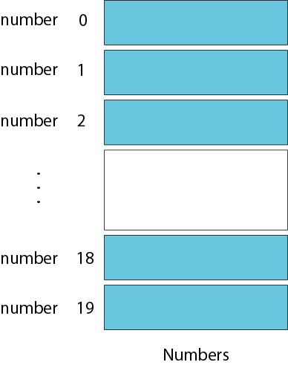
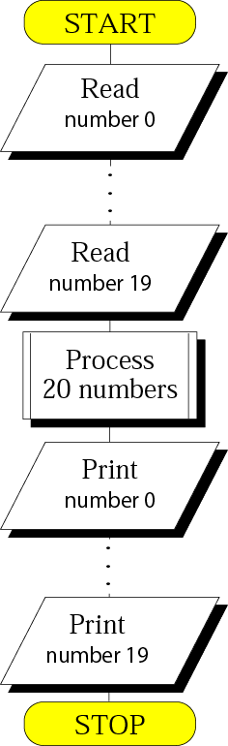
Problem: using 20 varialbes.
Twenty individual variables
Processing individual variables

Slide 6
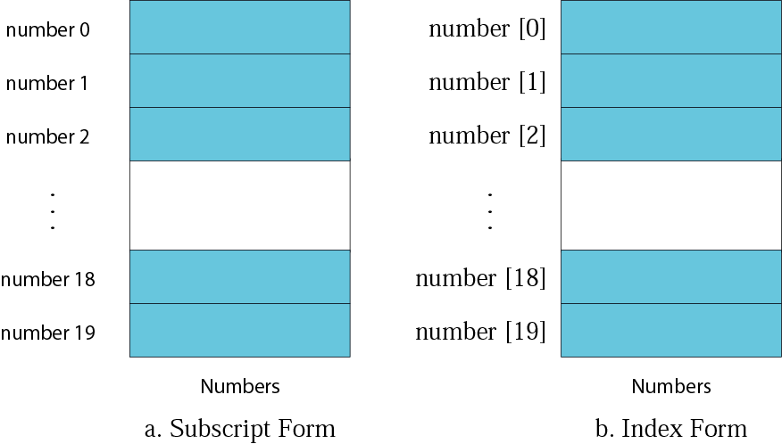
Resolution: using array.
A array is fixed-size,sequenced collection of elements of the same data type.
Arrays with subscripts and indexes

Slide 7
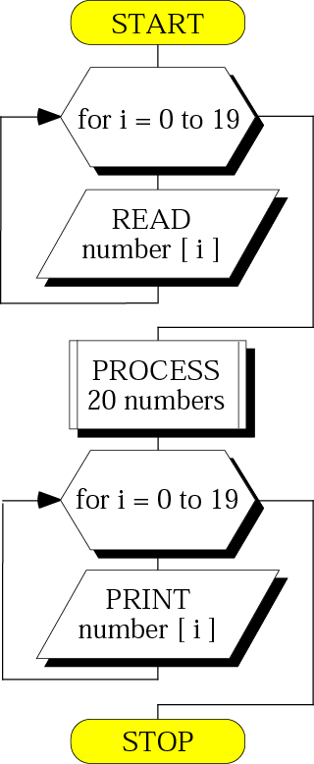
Figure 11-4
Processing an array

Slide 8
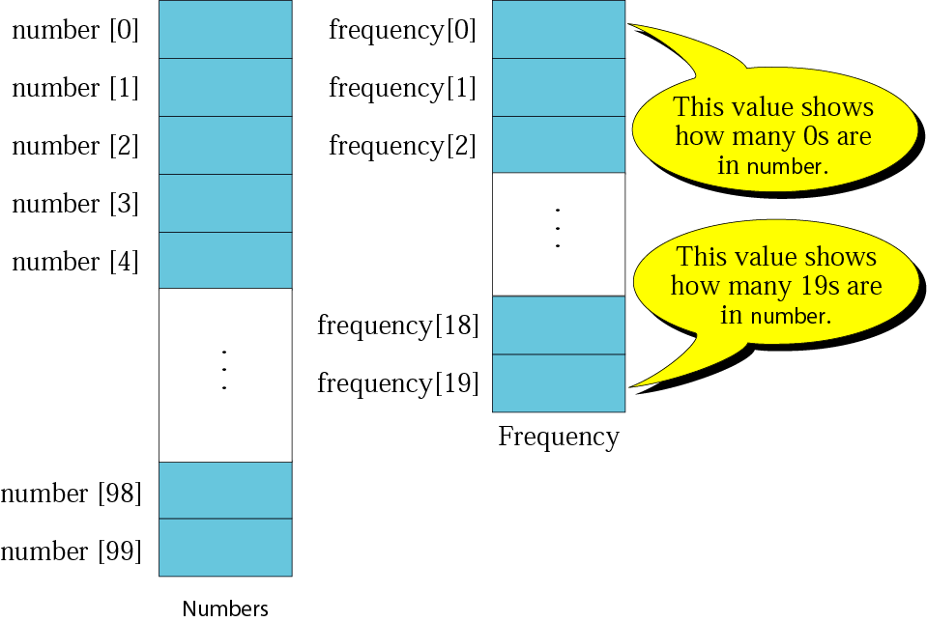
Figure 11-5
Frequency array

Slide 9
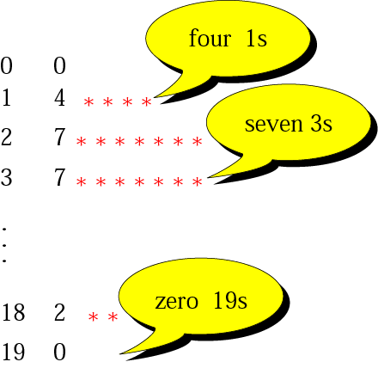
Figure 11-6
Histogram

Slide 10
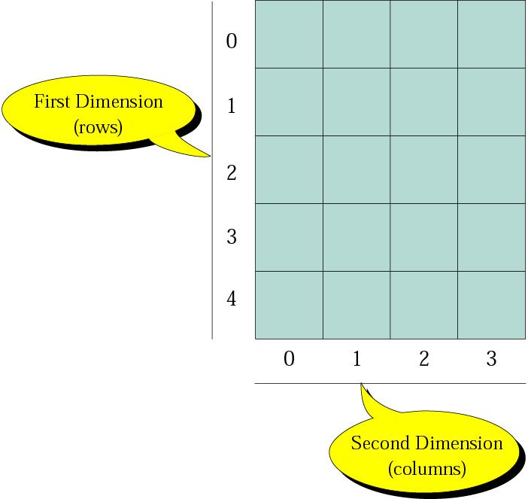
Figure 11-7- Part I
Two-dimensional array

Slide 11
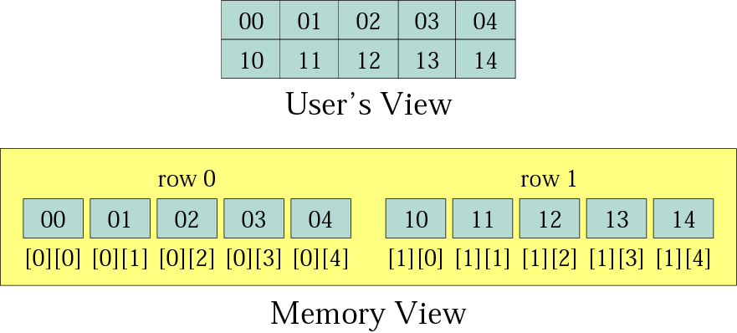
Figure 11-8
Memory layout

Slide 12
11.2
RECORDS

Slide 13
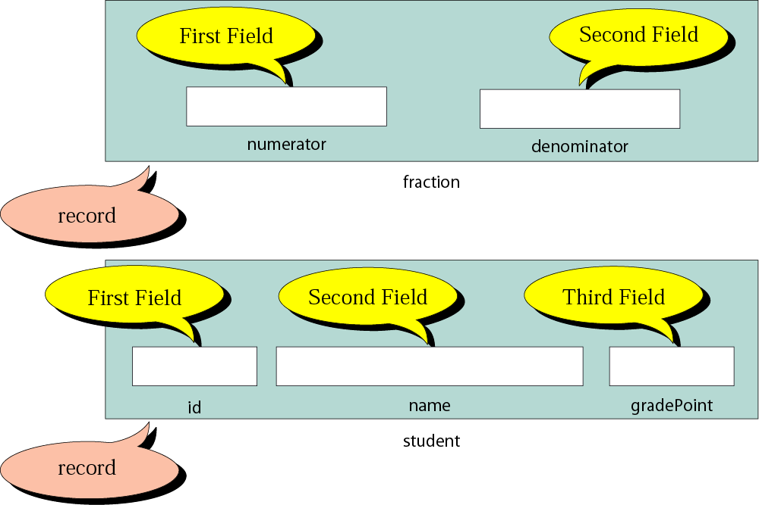
Figure 11-9
Records
A Recod is a collection of related elements, possibly of different types,have a single name.

Slide 14

Note:
The elements in a record can be of the same or different types. But all elements in the record must be related.
Accessing records,read write

Slide 15
11.3
LINKED
LISTS

Slide 16
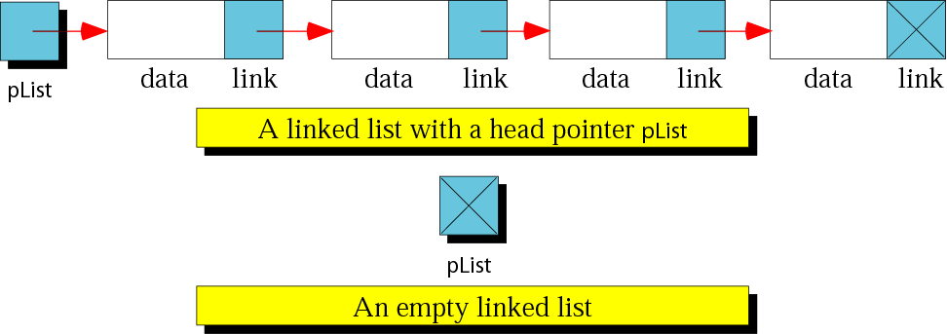
Linked lists
A Linked List is an ordered collection of data in which each element contains the location of the next element.
Each element contains two parts: data and link.

Slide 17

Figure 11-11
Node

Slide 18
Figure 11-11
Operations on Linked lists
Inserting a Node
Deleting a Node
Searching a List
Retrieving a Node(检索，取出)
Traversing a List

Slide 19
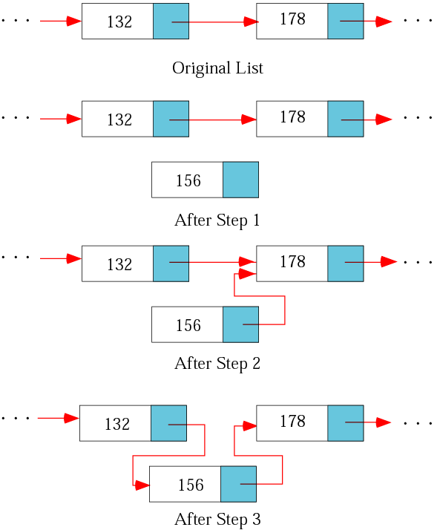
Figure 11-12
Inserting
a node
(1)Allocate memory for the new node and write data
(2)Make the new node point to its successor
(3)Make the predecessor point to the new node

Slide 20
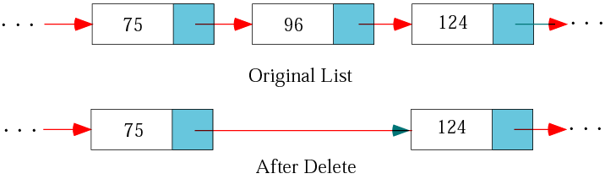
Figure 11-13
Deleting a node

Slide 21
Searching a List

Slide 22
Retieving a Node

Slide 23
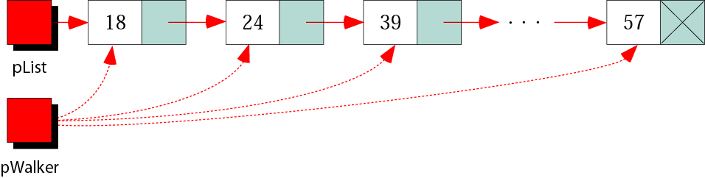
Figure 11-14
Traversing a list
Walking pointer

